Slide 1



SOFTWARE AND DESIGN ANALYSIS FINAL PROJECT’24
Veterinary Hospital and Shelter Management System

Slide 2

INTRODUCTION
Purpose: Tracking medical histories, scheduling appointments, and managing shelter operations.
Simplifies scheduling, record-keeping, improving communication and resource management to enhance care and operational efficiency.

Slide 3
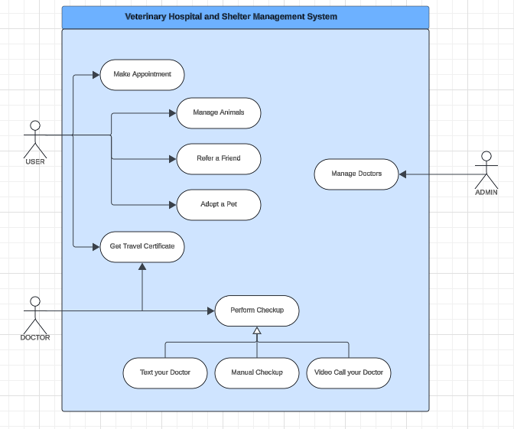


USE CASE DIAGRAM

Slide 4





NON-FUNCTIONAL REQUIREMENTS
Performance Requirements: The system must support multiple users simultaneously with quick access to records and appointments.
Safety Requirements: The system must ensure data integrity with backup mechanisms to prevent loss and operate consistently without crashes.
Business Rules: Appointments require mutual confirmation, travel certificates can only be issued by authorized staff, and shelter animals must pass health checks before adoption.

Slide 5
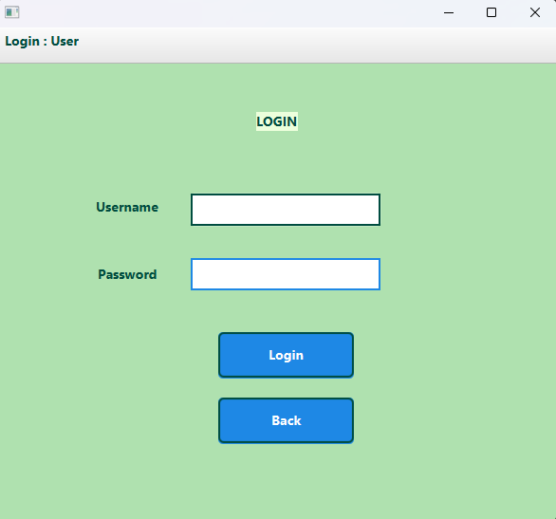
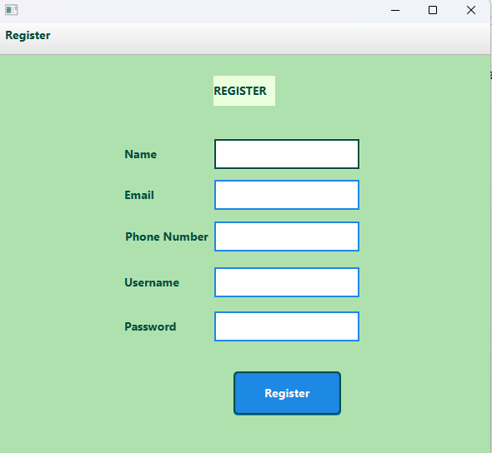
USER INTERFACES - DEMO
Main Pages - Login, Register

Slide 6
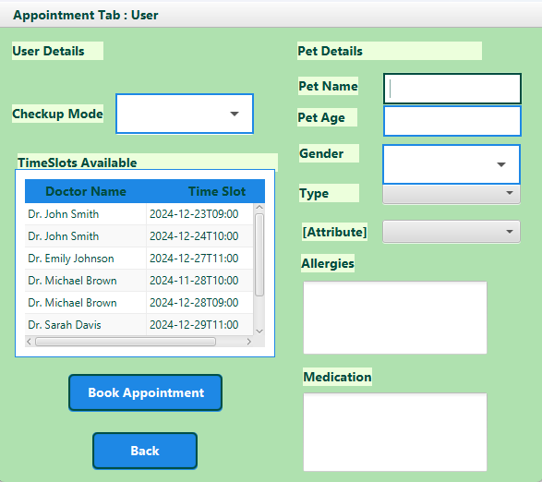
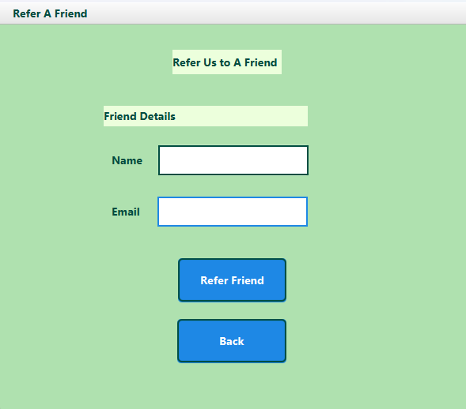
USER INTERFACES - DEMO
User Pages - Make Appointment, Refer a Friend

Slide 7
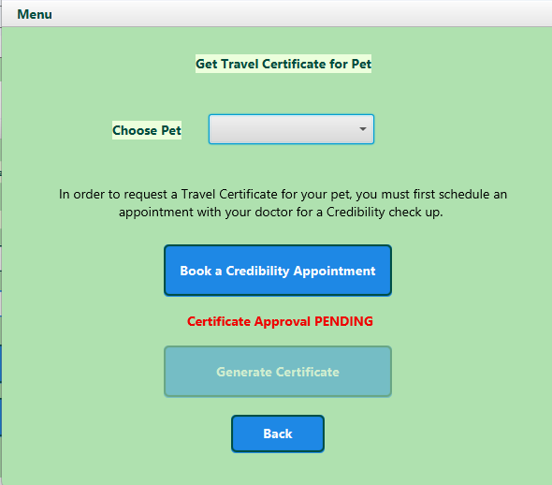
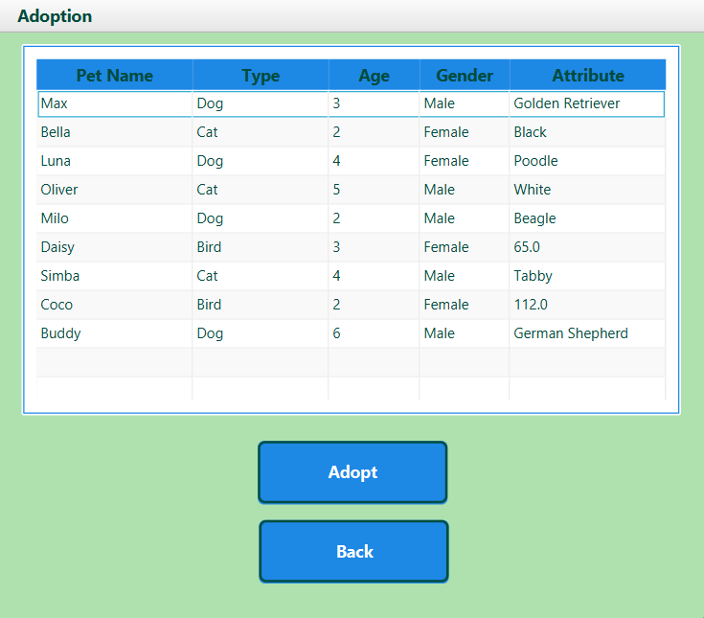
USER INTERFACES - DEMO
User Pages - Request Certificate, Adopt a Pet

Slide 8
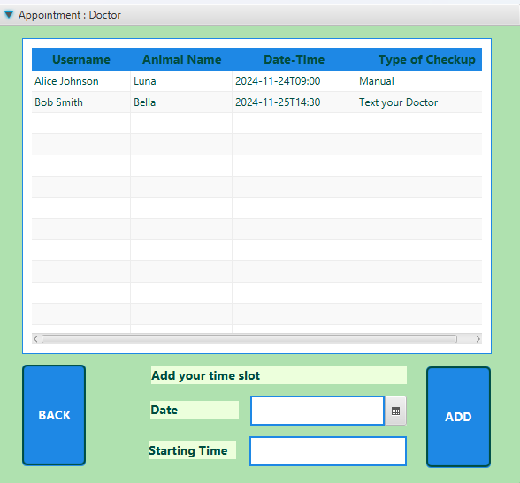
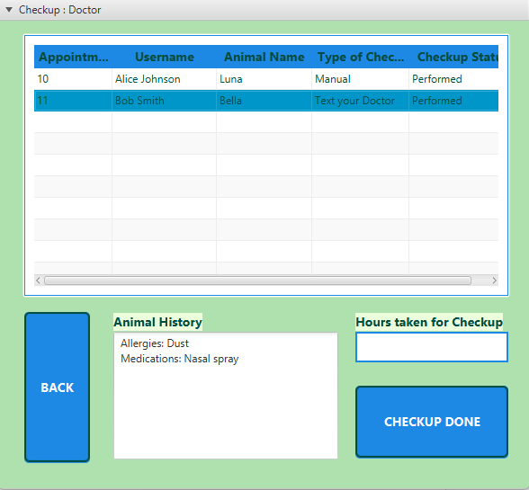
USER INTERFACES - DEMO
Doctor Pages - View Appointment, Perform Checkup

Slide 9
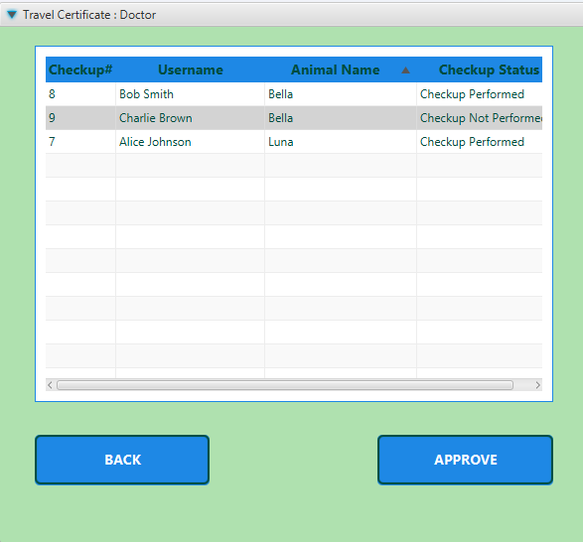
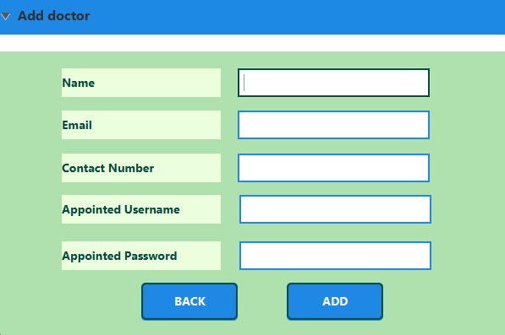
USER INTERFACES - DEMO
Doctor Pages - Approve certificate
Admin Page - Add Doctor

Slide 10
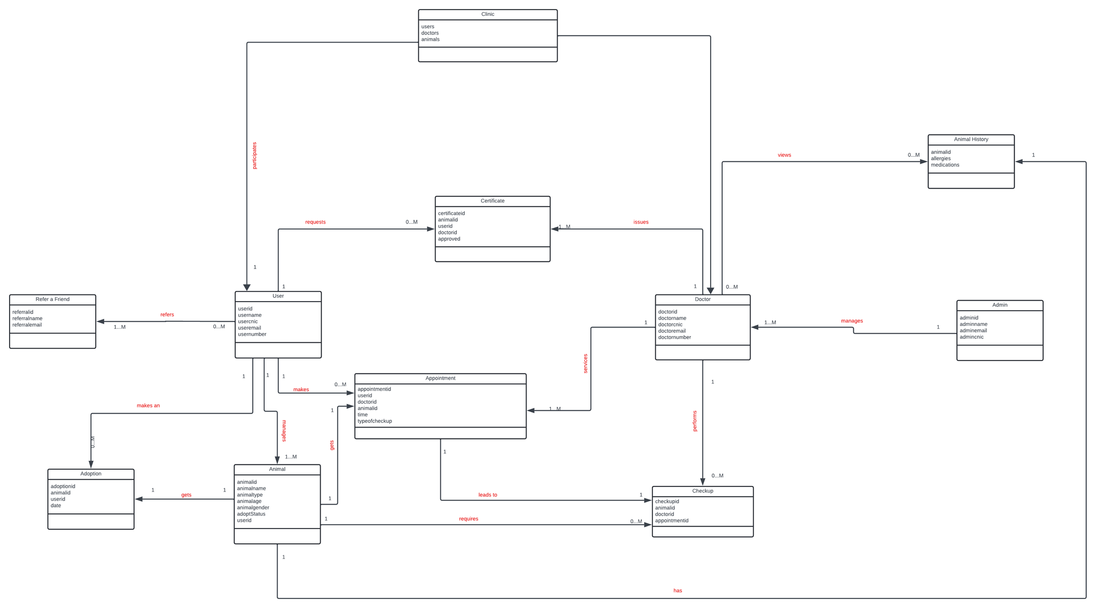
DOMAIN MODEL

Slide 11
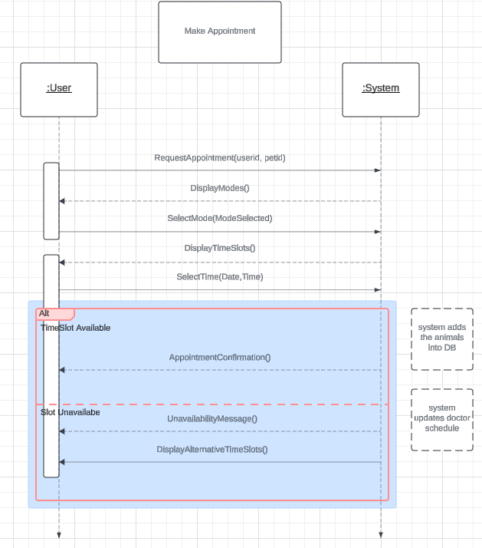
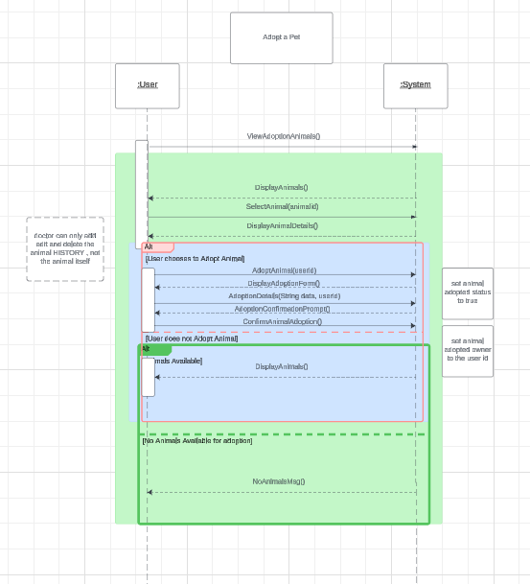
SYSTEM SEQUENCE DIAGRAMS

Slide 12
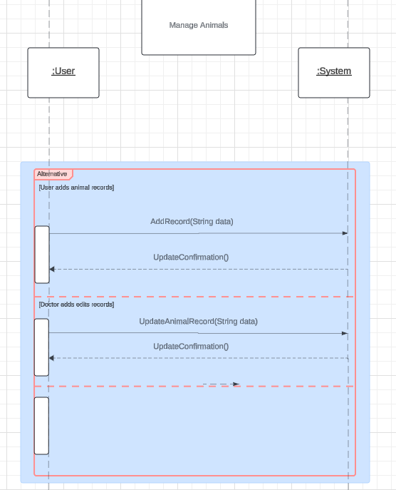
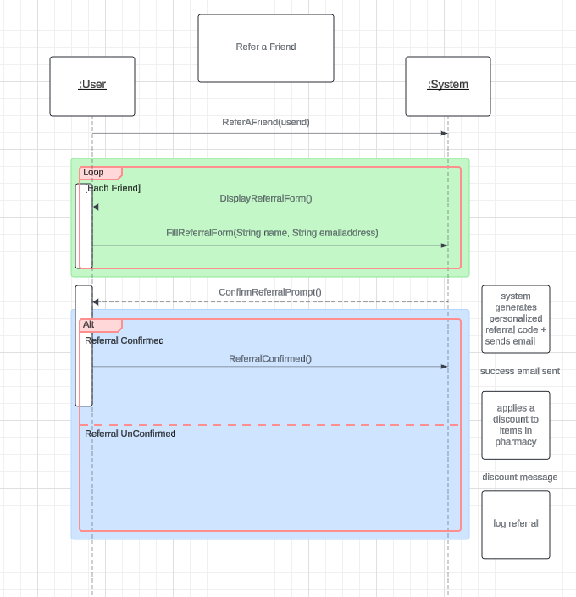

Slide 13
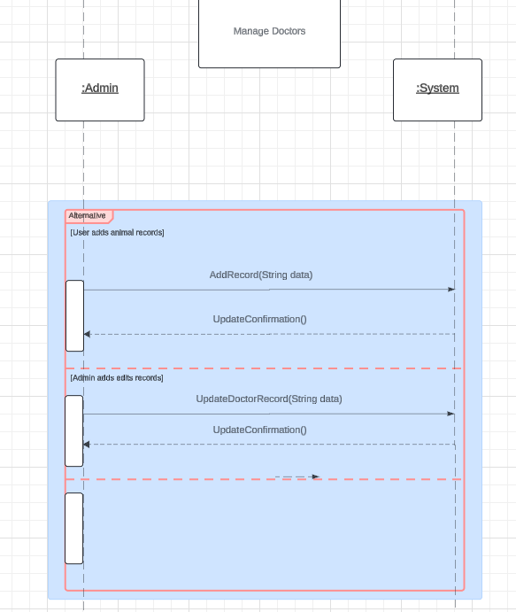

Slide 14
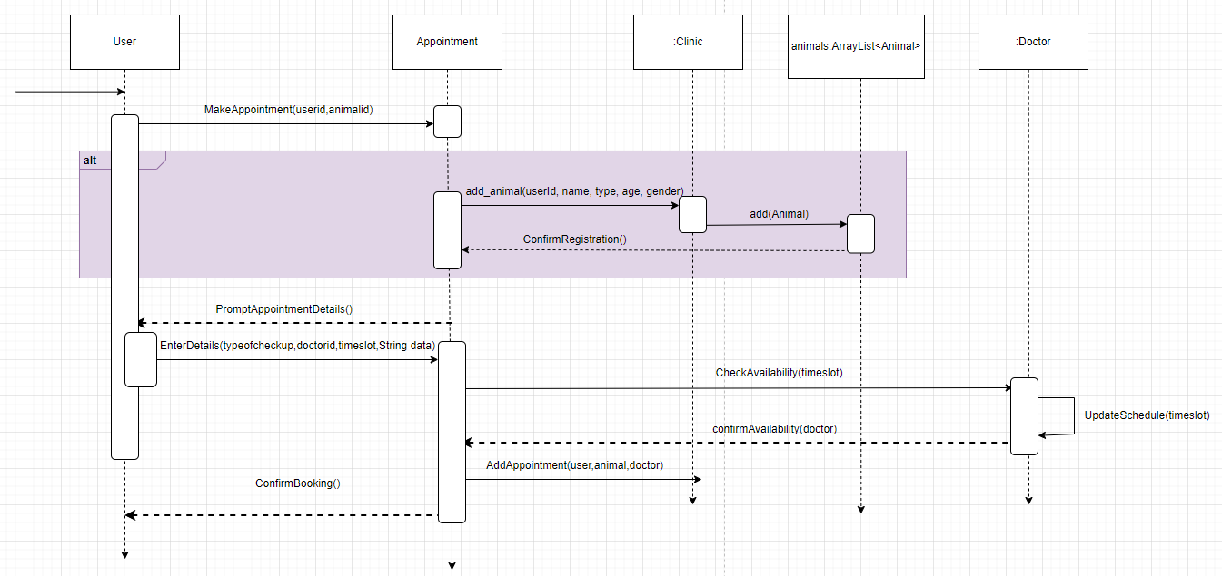
SEQUENCE DIAGRAM

Slide 15
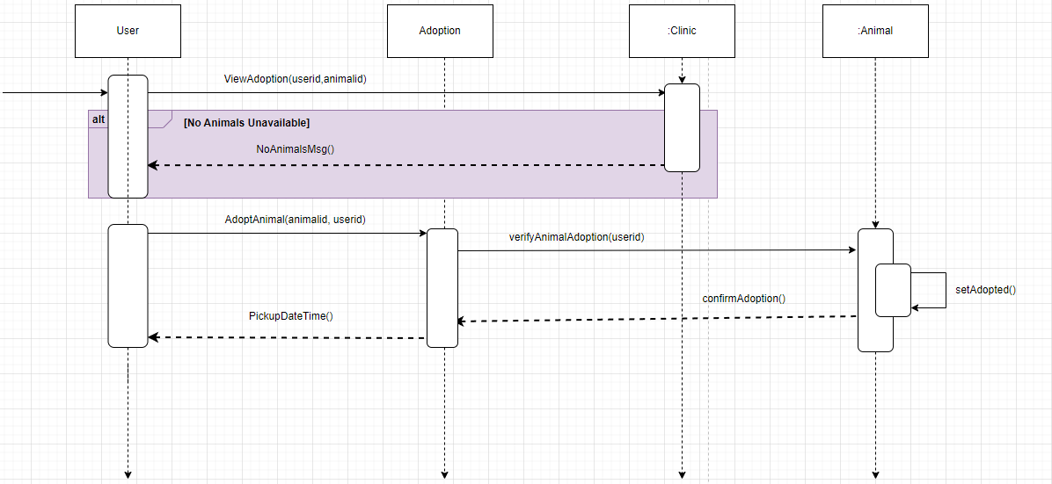

Slide 16
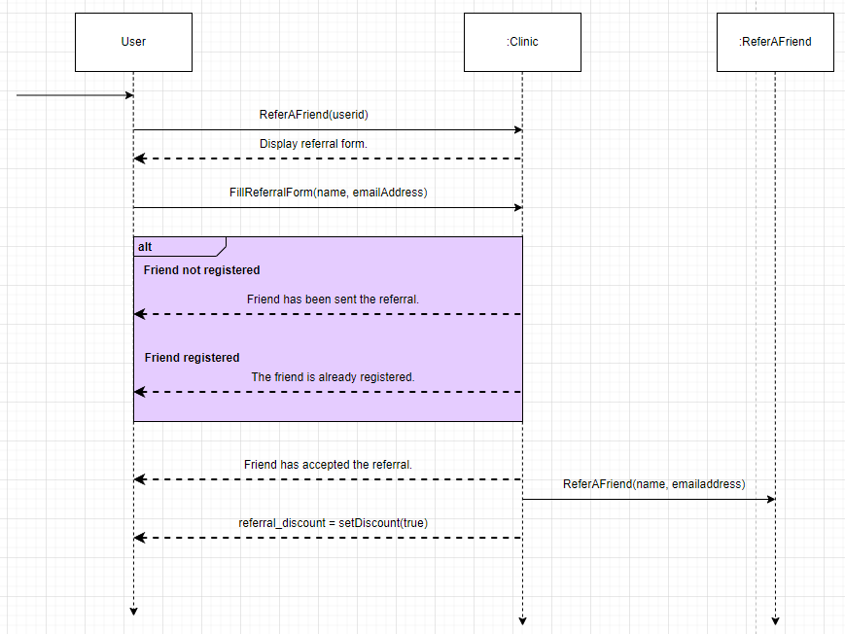

Slide 17
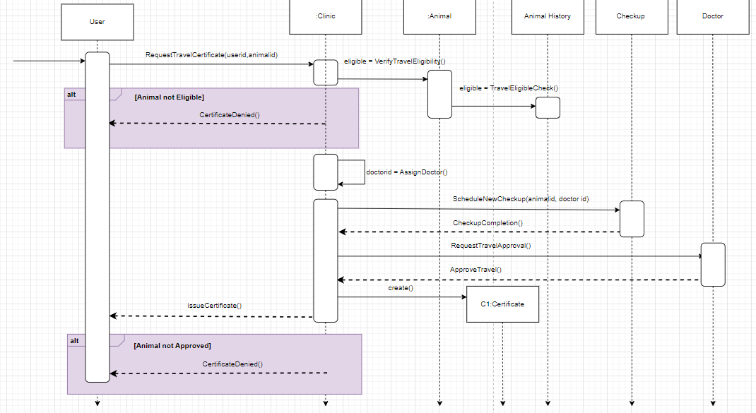

Slide 18
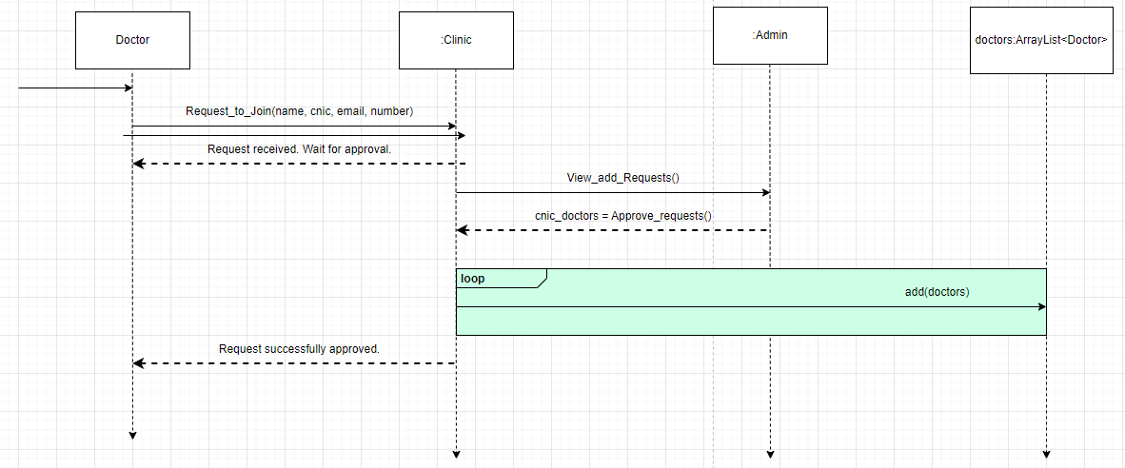

Slide 19
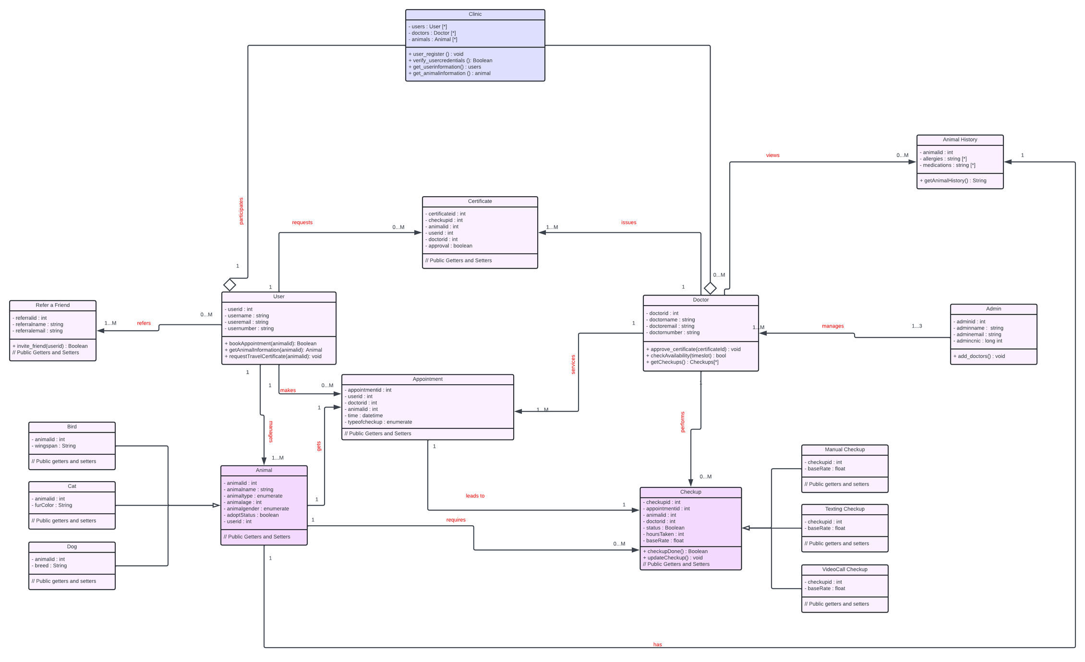
CLASS DIAGRAM

Slide 20
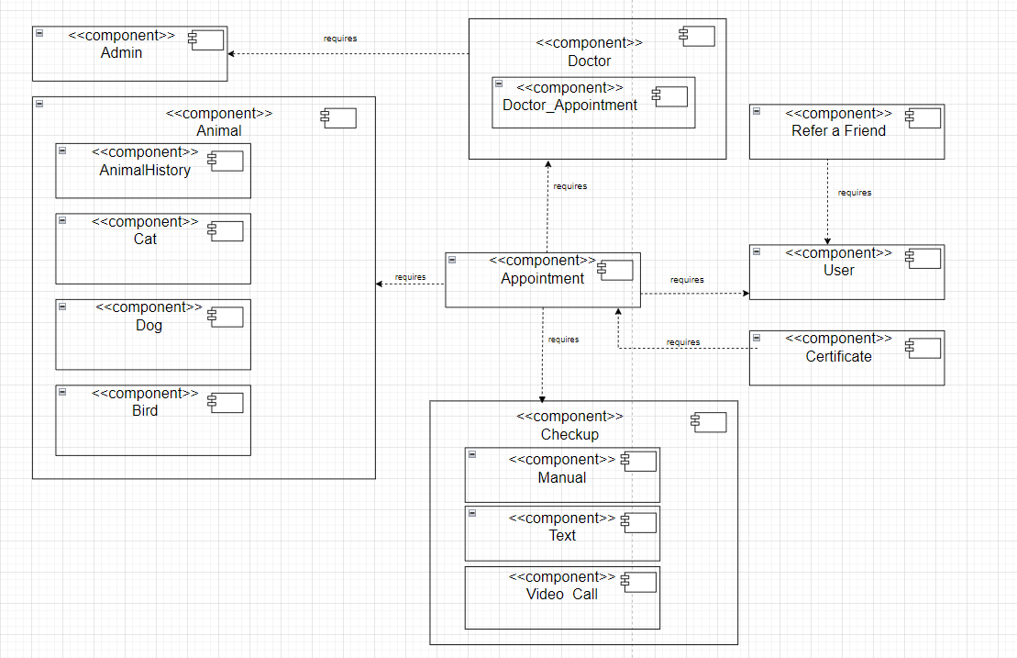
COMPONENT DIAGRAM

Slide 21
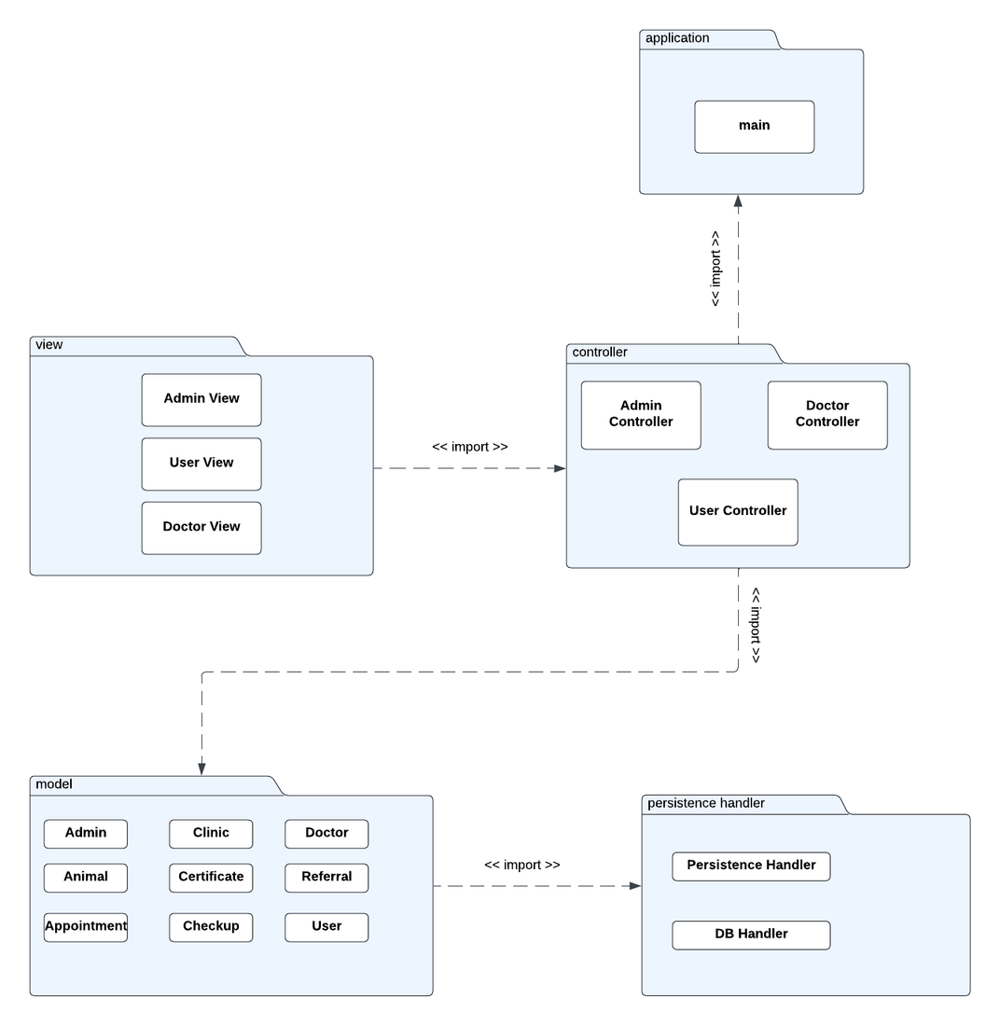
PACKAGE DIAGRAM

Slide 22
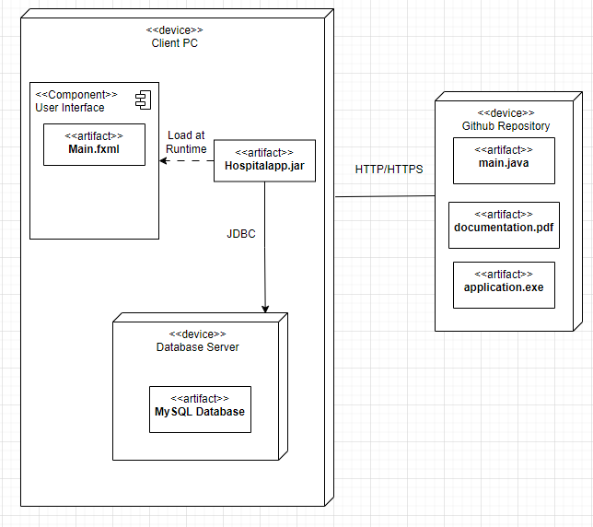
DEPLOYMENT DIAGRAM

Slide 23

DESIGN PATTERNS USED
GRASP PATTERNS USED:
Session Controllers (Corresponding to each Use Case)
Creator (User + Clinic)
Information Expert (Clinic + Animal History)
Low Coupling (animal_user + doctor_appointments + referAFriend)
High Cohesion - applied
GOF PATTERNS USED:
Singleton (Admin, User, SQL Handler)
Factory (Animal creation)
Strategy (CheckUp Types)
Observer (Travel Certificate Approval)

